Slide 1
Decoding Decisions
Making sense of the messy middle

Slide 2
Download the full research report: g.co/think/messymiddle
Notes:
This presentation is a summary of a new report that you can download in full here….

Slide 3
Defining the messy middle
Notes:
In between the purchase trigger, and actually making the purchase itself, today’s consumer is presented with a vast amount of information and choice across a complex web of touchpoints [e.g. search engines, review sites, social media, retailers, comparison sites, video sharing sites, aggregators etc].
If you were to sketch that out on a piece of paper, you might end up with something like this - we call it the ‘messy middle’.
Is all of this behaviour being fully captured by our often siloed brand and performance marketing practices? One of the biggest challenges for brands is ensuring that customers - both existing and new - don’t fall through the gaps in this complex space. A space where, as our research shows, customer are won and lost. To do that, behaviour in the messy middle needs to be decoded.

Slide 4
Decoding the messy middle
Awareness
Familiarity
Consideration
Purchase
Loyalty
Notes:
But decoding that behaviour is a challenge.
We could use the purchase funnel - not the latest marketing model, but still widely referenced, and can still be a useful tool for planning.
But anyone who’s ever read any behavioural science books, or anyone who can relate the spaghetti like mess on the previous slide, knows that purchase decision making doesn’t follow this linear process. It’s complex, not always done consciously and subject to behavioural biases.

Slide 5
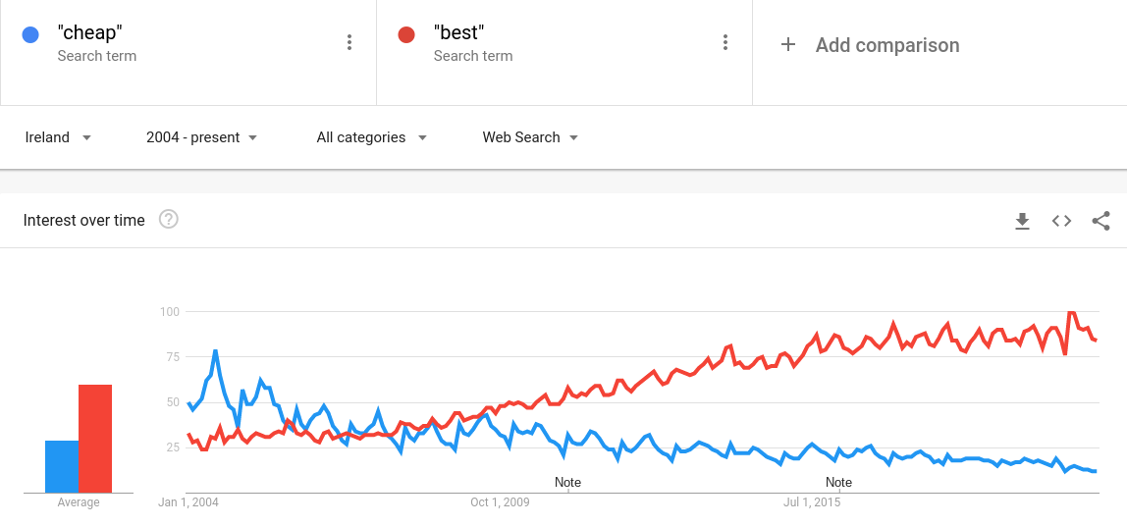
Cheap, or best?
Notes:
Our Search data sheds some light on decision making behaviour over time
This chart shows the use of the words “cheap” and “best” in searches. When the internet, and search, were young, there was a clear bias towards price comparison - people using the internet to find the cheapest. Now, the internet has gone from a tool for comparing prices, to a tool comparing everything. And consumers want the best. [UPDATE COMMENTARY IF USING LOCAL GOOGLE TRENDS DATA TO UPDATE THE CHART]
A really valuable insight, but what does ‘best’ actually mean? Best quality? Best performance? Best value? Most popular? All of the above perhaps? What information is it based on and where does it come from? All questions that still need to be answered

Slide 6
A methodology to address the challenges
Observation of shopping journeys
Hundreds of hours of shopping behaviour, analysed through the lense of behavioural science
Literature review
Extensive review of behavioural science to identify cognitive biases in consumer decision making
Simulated purchases
Thousands of simulated purchase scenarios to test and validate the role of those biases at scale
Notes:
Behavioural scientists have been studying the science of human decision making for decades, so to address the challenge of understanding how shoppers make decisions in the messy middle, we partnered with The Behavioural Architects, behavioural science specialists. And we did three things [optional methodology detail available in the appendix]:
Observation of shopping journeys - we used screen and audio recordings to capture hundreds of hours of shoppers making purchases decisions. Then we analysed this through the lense of behavioural science to update our understanding of decision making behaviour
Literature review - over the last 50 years or so, behavioural scientists have identified about 300 principles that underpin human behaviour. We conducted an extensive literature review of the behavioural science literature to identify 6 cognitive biases from that list of 300 that we feel are most relevant to decision making in the messy middle
Simulated purchases - To test and validate those biases at scale, we created a simulated purchases environment. We picked out a range of products that represent varying degrees of purchase decision complexity and enjoyment. Then we recruited 1,000 in-market shoppers for each of those products. They each completed 10 simulated purchases scenarios. That’s [THIS NUMBER APPLIES TO THE COUNTRY IN THE TITLE OF THIS FILE ONLY] 310,000 simulated purchases. This allowed us to simulate the transfer of preference from one brand to another using different combinations of the 6 selected biases

Slide 7
An updated model of purchase decision making
Notes:
The first job is to untangle this mess.
So based on our observations of shopping and behaviour and our literature the literature review, we have updated our model of consumer decision making. It’s an evolution of models you may have seen before, but there some important updates that we feel are essential to understanding modern consumer decision making, so we’re going to walk through it step by step

Slide 8
Exposure: A constantly present underlying net of external factors
Notes:
Firstly, all decisions are made against a background of exposure
Not an entirely new concept - this would include what we typically refer to as brand awareness. But exposure it’s more than that, in addition to that TV campaign, it's also a conversation you overheard in a coffee shop.
And the really important distinction here, is that unlike awareness that sits on top of the purchase funnel, exposure its always on, its always changing and it's always influencing decision making right the way through the process. So, it’s not a stage of the process, it's the backdrop to entire process.

Slide 9
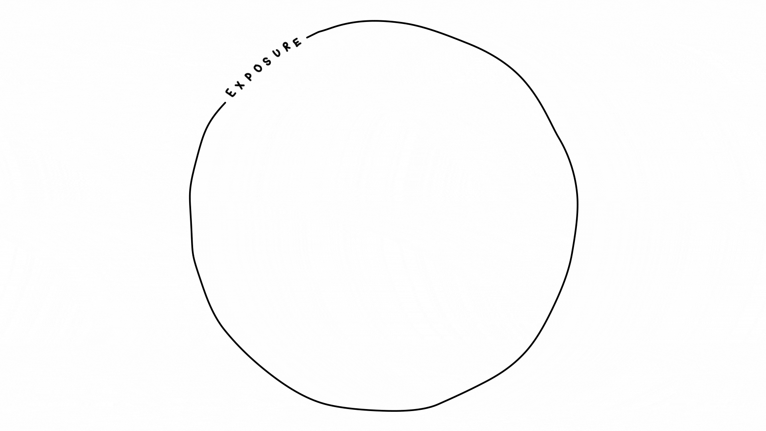
Notes:
At some a purchase is triggered, at this point the shoppers moves from a passive state, into an active state of purchase decisions making
And eventually - hopefully - there is eventually a purchase

Slide 10
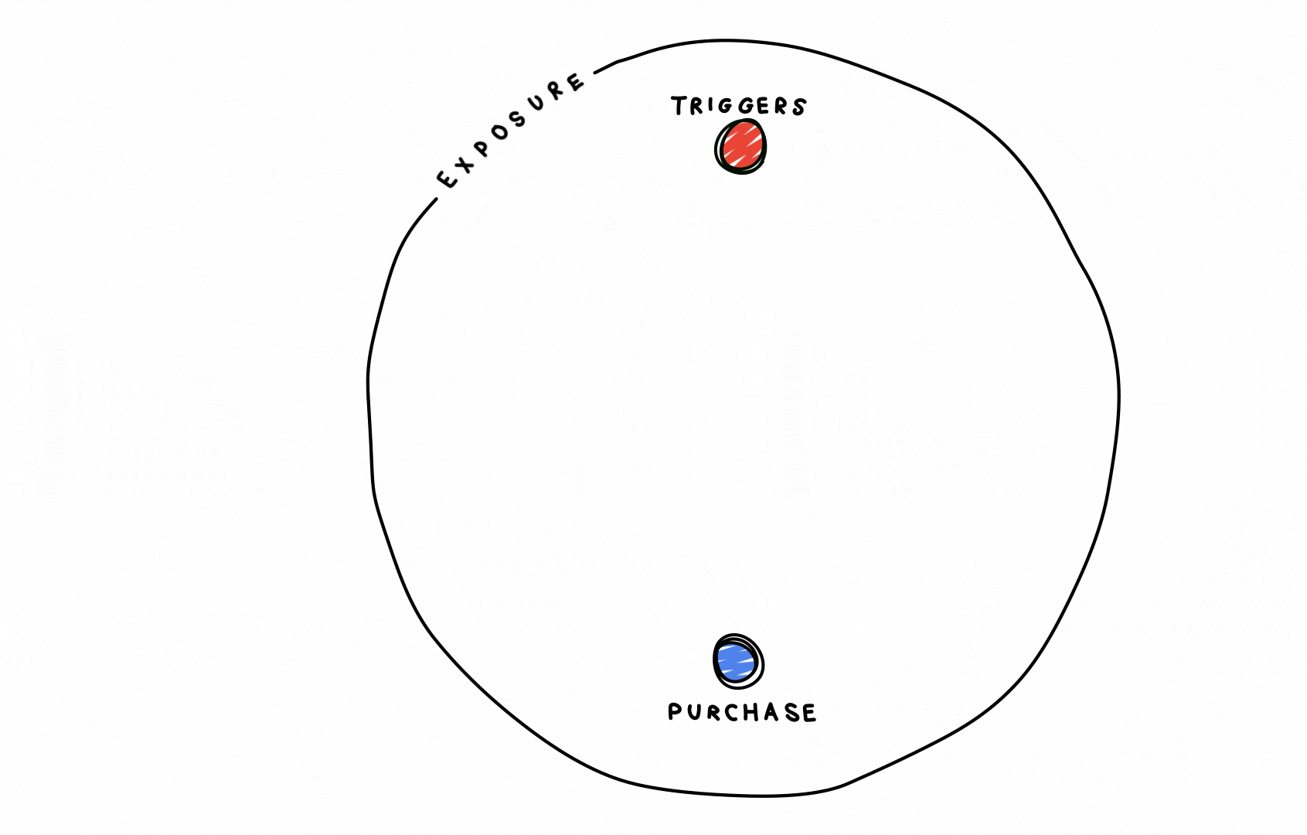
Notes:
Then there is the really messy bit, all the activity that happens in between the trigger and the purchase itself

Slide 11
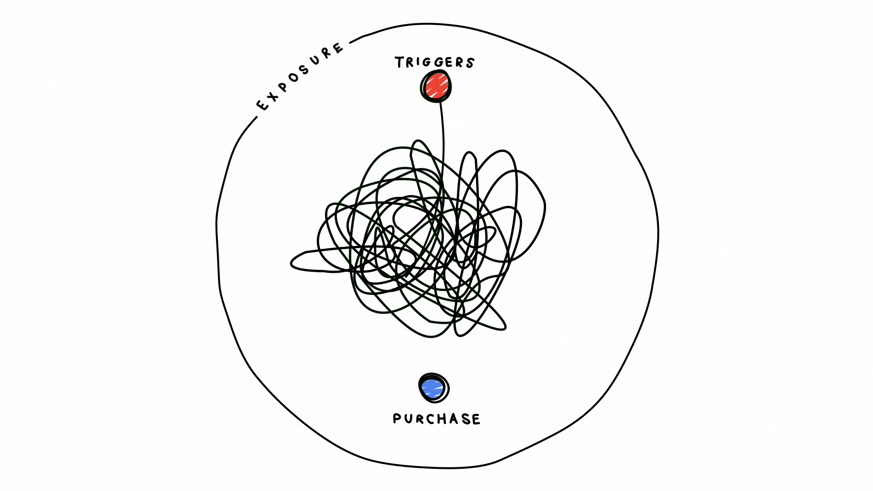
Notes:
We’ve taken all the behaviour in the messy middle, whatever is and wherever it happens, and codified into one of two metal modes: exploration and evaluation

Slide 12
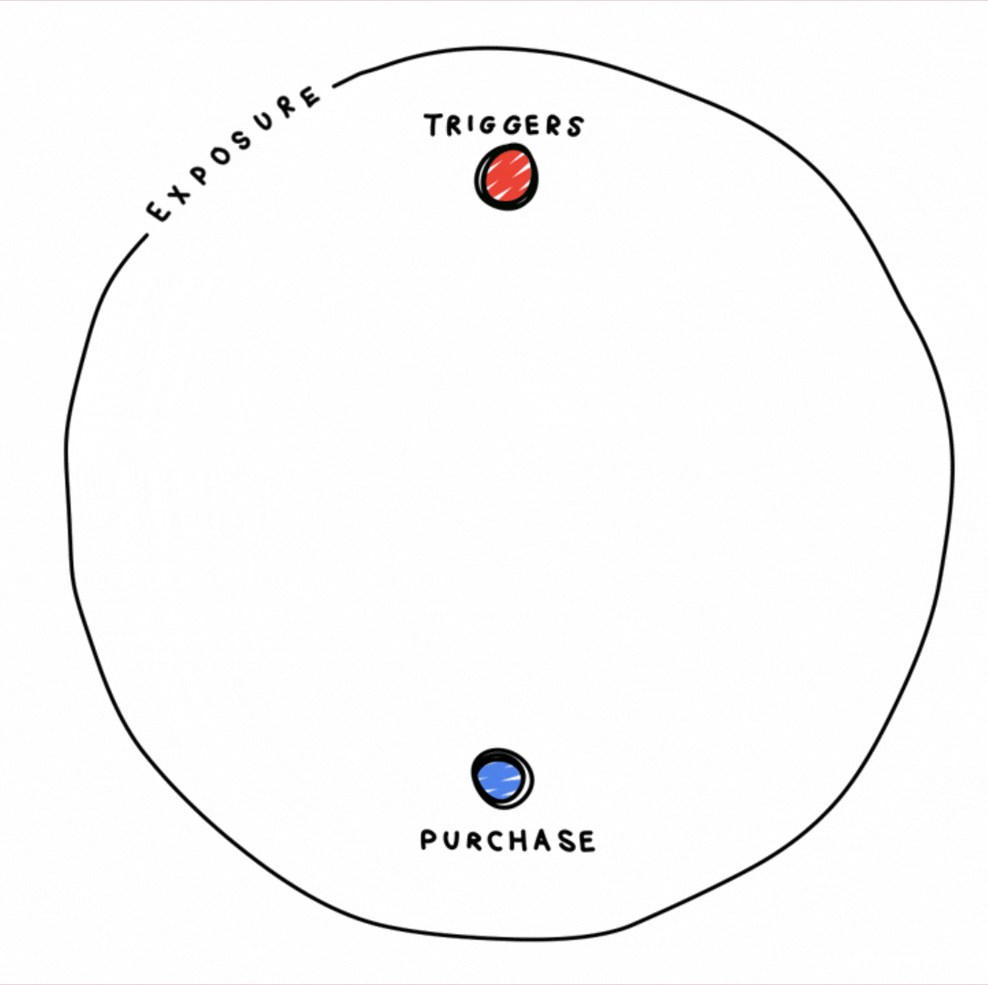
A continuous cycle of expansion and reduction: In Exploration mode we expand our consideration set
In Evaluation mode we narrow down our options
Notes:
Whatever the shopper is doing in between trigger and purchase (and whether or not they’re doing it consciously) they are doing one of two things; exploring or evaluating.
These two tasks can happen either simultaneously, or sequentially, but (according the science ) they are two distinct mental processes with separate reward structures.
Exploration mode is an expansive exercise - here we add brands to our consideration set.
Evaluation mode is a reductive exercise - in this mode we narrow down are options.
But! Because of the sheer volume of information and choice available, and the speed and ease at which we acquire it, we are encouraged, compelled and sometimes (for more complex purchases) even obliged to go back into exploration mode which generates new options that then in turn need to be evaluated, creating this loop.
Depending on who you are and what you’re shopping for that can be fun, but from a marketing perspective, this is not fun, and it’s certainly not efficient, so, how do we get our customers from trigger to purchase as efficiently as possible?

Slide 13
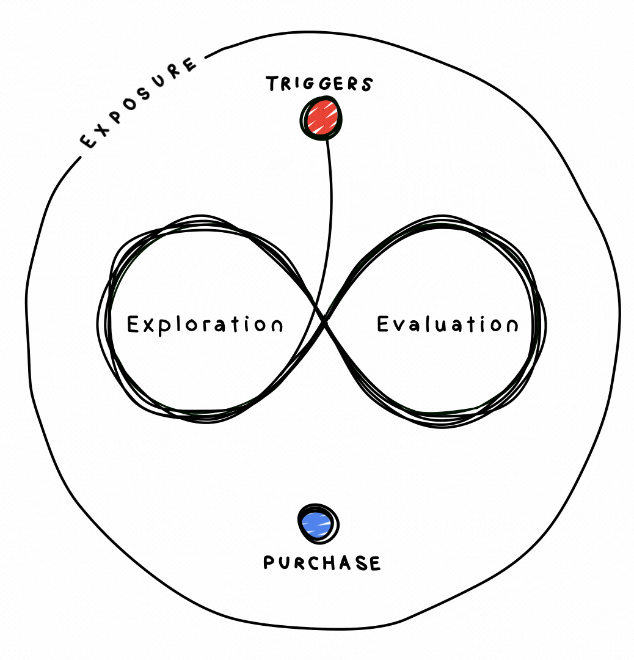
The role of Experience: Experience feeds into Exposure and influences subsequent journeys
Notes:
Now this happens outside of the messy middle and we haven’t got time to cover this is any real detail today, but it’s important to mention that once the purchase is made, there will be some post purchase experience that will feed back into exposure. The nature of that experience, and whether or not it was positive, will form a key part of exposure when the purchase is next triggered (possibly even the frequency of that trigger, or if in fact it’s triggered again at all!)
Slow loading pages, poor site speed, clunky UX - all of these things hinder exploration and evaluation. If the experience is negative, customers will evaluate you negatively and will go and explore somewhere else, i.e. a competitor website.
So, hugely important, but not something we’ll address today.

Slide 14
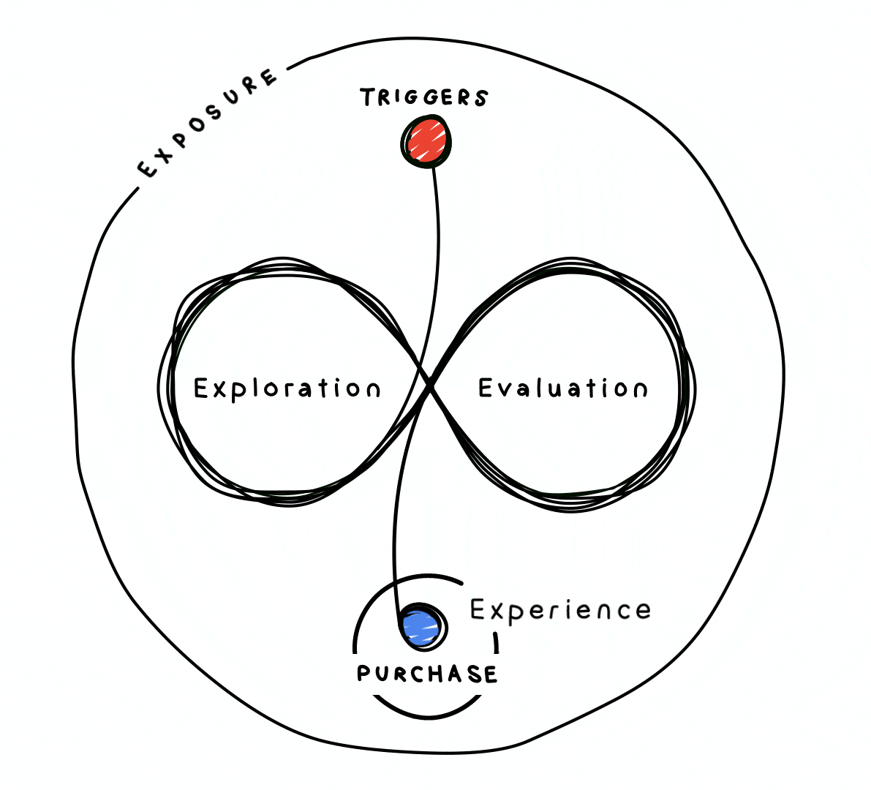
Notes:
So there we have it - we’ve brought some order to the the chaos - in this updated model of consumer decision making

Slide 15
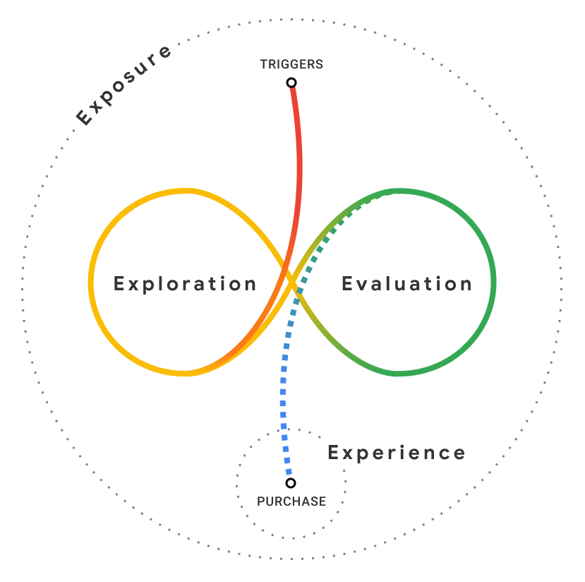
OFF-LIMITS
Brand Strategy
Category
Heuristics
Authority Bias
PLAYABLE
Scarcity Bias
Power of Free
Social Norms
Power of Now
OFF-LIMITS
Pricing strategy
Notes:
We’ve codified the behaviour, but now we need to know how shoppers process all that information and choice as they explore and evaluate in the messy middle. This is where the six cognitive biases that we identified in our literature review come in
But before we look at those, we need to establish a couple of boundaries
The research is not intended to guide brand strategy - The careful crafting of the brand, and the awareness of that brand up until the purchase is triggered is not covered here.
This research is not intended to inform pricing strategy either. Like branding, pricing not so easily changed either - it’s also outside of our remit (and in the purchase simulations that follow, we control for price by telling participants they will be pay the expected market value for a product)
No brand strategy, no pricing strategy. That leaves us with this eminently playable space in the middle (the messy middle) where some of these of these biases, despite being grounded in years of scientific study, may only require a simple cosmetic change to become effective (e.g. tweaking copy or re prioritising content).

Slide 16
Category Heuristics
We rely on shortcuts or rules of thumb to help us to make quick & easy decisions
Notes:
[Refer to slide]
When you’re shopping for food, the word organic can mean quality, healthy, ecologically / environmentally friendly, properly sourced - all of that from one word

Slide 17
Social Norms
Authority Bias
We adopt the opinions and follow the behaviours of the majority
We follow the lead of credible, knowledgeable experts
Notes:
[Refer to slide]

Slide 18
There’s no time like the present...
Power of Now
Scarce resources are more desirable
Scarcity Bias
Free things are
immensely attractive
Power of Free
Notes:
[Refer to slide]

Slide 19
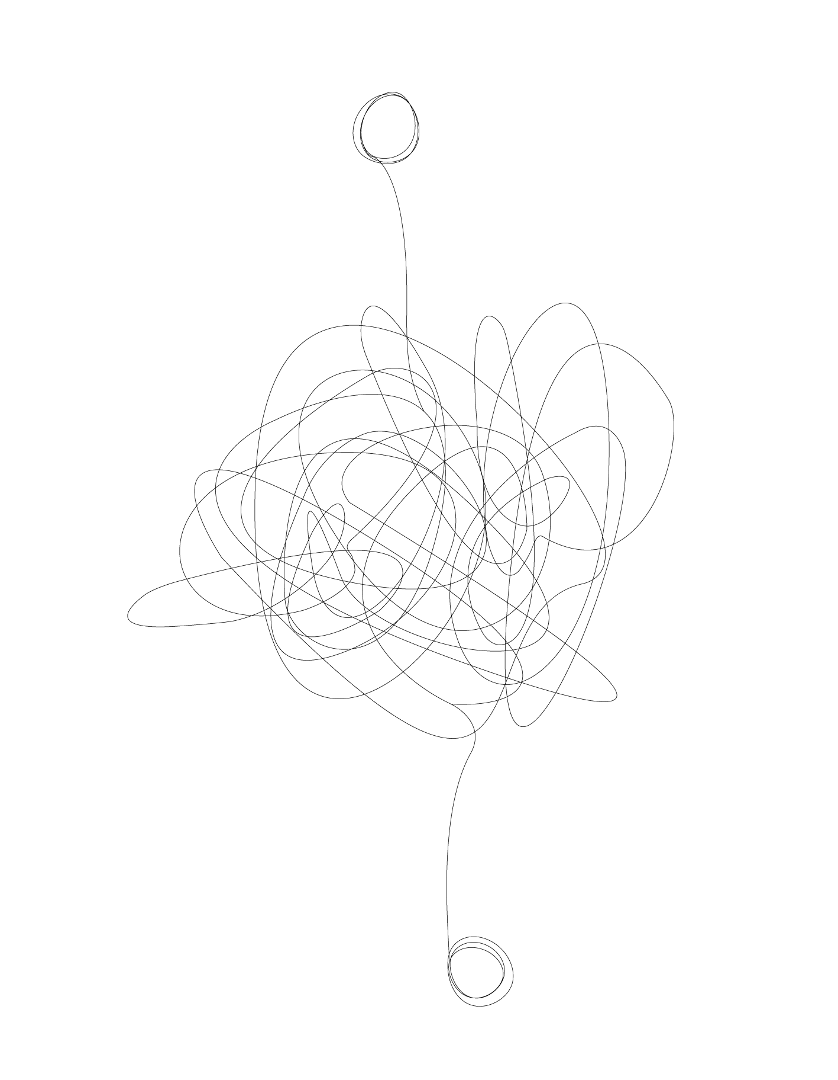
Purchase Simulation
Notes:
Now we come to purchase simulation, where we will test and validate are seven 6 cognitive biases at scale, and the role of brand preference, at scale.
As a reminder, for each product we’ve selected, we’ve recruited 1,000 in-market shoppers, and they’ve each done 10 simulated purchase scenarios.

Slide 20
Purchase Simulation
Fave
Brand
No.2
Brand
Notes:
Before the simulation begins, we ask the shopper for their favourite, and their second favourite brand in a given category.

Slide 21
Purchase Simulation
Authority Bias
Scarcity Bias
Category
Heuristics
Power of Free
Social Norms
Power of Now
CHOOSE
Fave
Brand
No.2
Brand
Notes:
Then once the simulation begins we build a proposition for each of those brands based on the six principles of behavioural science.
What we have created here is a platform where we can test is if these cognitive biases can tempt a shopper away from their favourite brand to what is, according to the shopper at least, an inferior brand.

Slide 22
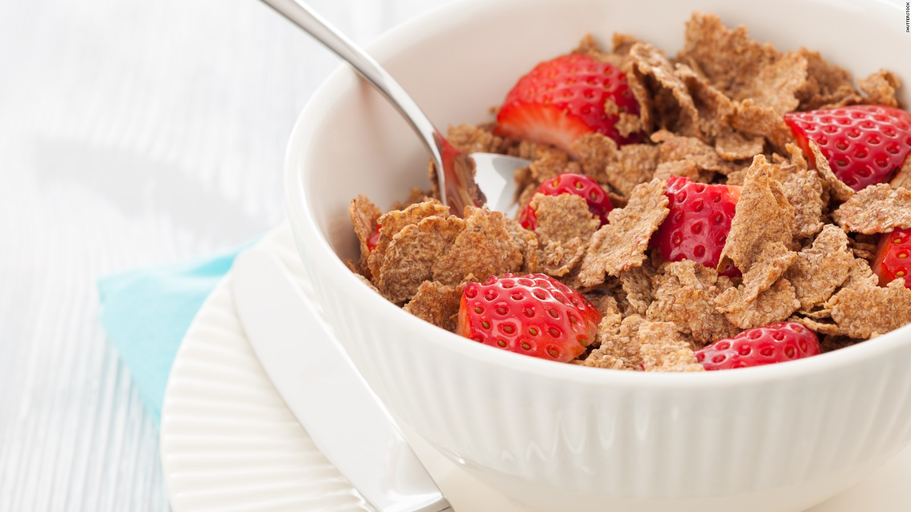
Cereal

Slide 23
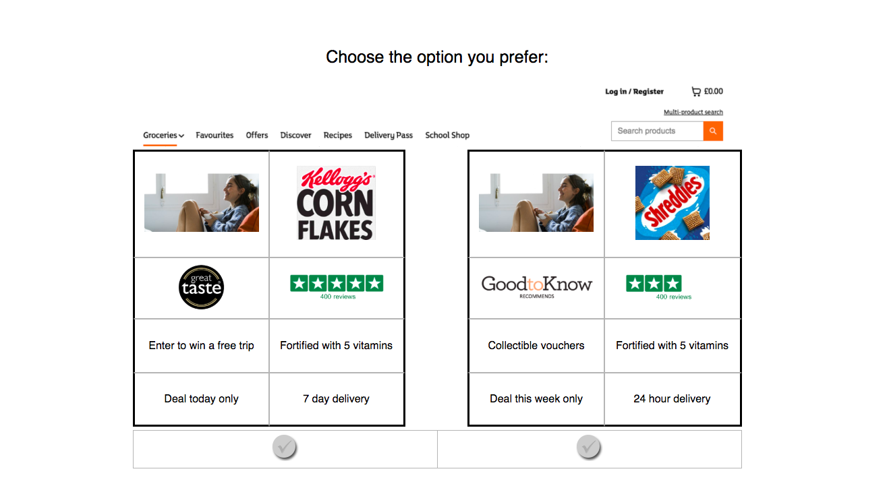
Brand 1
Brand 2
Enter to win
a free trip
Fortified with 5 vitamins
20% extra free
High fibre
Deal today only
7 day delivery
Deal this week only
24 hour delivery

Slide 24
Cereal - Stated Preference
100%
100
80%
70
60%
67
40%
20%
0%
Stated 1st choice brand
1st choice brand share
Source: Google commissioned UK research conducted by The Behavioural Architects. Based on 10,000 conjoint purchase simulations. n=1,000 category buyers (1,000 respondents, 10 simulations each). Respondents who never use Google Search or never use Amazon (2% of category buyers aged 18-65) were screened out before participating in the research

Slide 25
Brand 1
Brand 2
Enter to win
a free trip
Fortified with 5 vitamins
20% extra free
High fibre
Deal today only
7 day delivery
Deal this week only
24 hour delivery
Notes:
[Note: propositions for both brands are identical in this example, to test what happens when you introduce the 2nd choice brand with the same proposition]

Slide 26
Cereal - Introduction of 2nd choice brand
100%
100
33
80%
60%
67
67
40%
20%
0%
Stated 1st choice brand
Introduction of 2nd choice brand
1st choice brand share
2nd choice brand share
Source: Google commissioned UK research conducted by The Behavioural Architects. Based on 10,000 conjoint purchase simulations. n=1,000 category buyers (1,000 respondents, 10 simulations each). Respondents who never use Google Search or never use Amazon (2% of category buyers aged 18-65) were screened out before participating in the research

Slide 27
Authority Bias
1st choice brand
2nd choice brand

Slide 28
Power of Free
Enter to win
a free trip
20% extra free
1st choice brand
2nd choice brand

Slide 29
2nd choice brand ‘charged’
100%
100
33
46
Authority Bias
80%
Power of Free
70
60%
67
67
40%
54
20%
0%
Stated 1st choice brand
Introduction of 2nd choice brand
2nd choice charged
1st choice brand share
2nd choice brand share
Source: Google commissioned UK research conducted by The Behavioural Architects. Based on 10,000 conjoint purchase simulations. n=1,000 category buyers (1,000 respondents, 10 simulations each). Respondents who never use Google Search or never use Amazon (2% of category buyers aged 18-65) were screened out before participating in the research

Slide 30
Social Proof
(400)
(400)
1st choice brand
2nd choice brand

Slide 31
Category Heuristics
Fortified with
5 vitamins
High fibre
1st choice brand
2nd choice brand

Slide 32
Power of Now
7 day delivery
24 hour delivery
1st choice brand
2nd choice brand

Slide 33
Scarcity
Deal today
Deal this week
1st choice brand
2nd choice brand

Slide 34
2nd choice brand ‘supercharged’
100%
100
33
46
73
Authority Bias
80%
Power of Free
70
60%
67
67
Scarcity Bias
40%
54
Social Norms
20%
Category
Heuristics
27
Power of Now
0%
Stated 1st choice brand
Introduction of 2nd choice brand
2nd choice charged
2nd choice supercharged
1st choice brand share
2nd choice brand share
Source: Google commissioned UK research conducted by The Behavioural Architects. Based on 10,000 conjoint purchase simulations. n=1,000 category buyers (1,000 respondents, 10 simulations each). Respondents who never use Google Search or never use Amazon (2% of category buyers aged 18-65) were screened out before participating in the research

Slide 36
Test brand ‘supercharged’
100%
100
33
46
73
28
Authority Bias
80%
Power of Free
70
72
60%
67
67
Scarcity Bias
40%
54
Social Norms
20%
Category
Heuristics
27
Power of Now
0%
Stated 1st choice brand
Introduction of 2nd choice brand
2nd choice charged
2nd choice supercharged
Test brand supercharged
1st choice brand share
2nd choice brand share
Test brand share
Source: Google commissioned UK research conducted by The Behavioural Architects. Based on 10,000 conjoint purchase simulations. n=1,000 category buyers (1,000 respondents, 10 simulations each). Respondents who never use Google Search or never use Amazon (2% of category buyers aged 18-65) were screened out before participating in the research

Slide 37
Car (SUV)

Slide 38
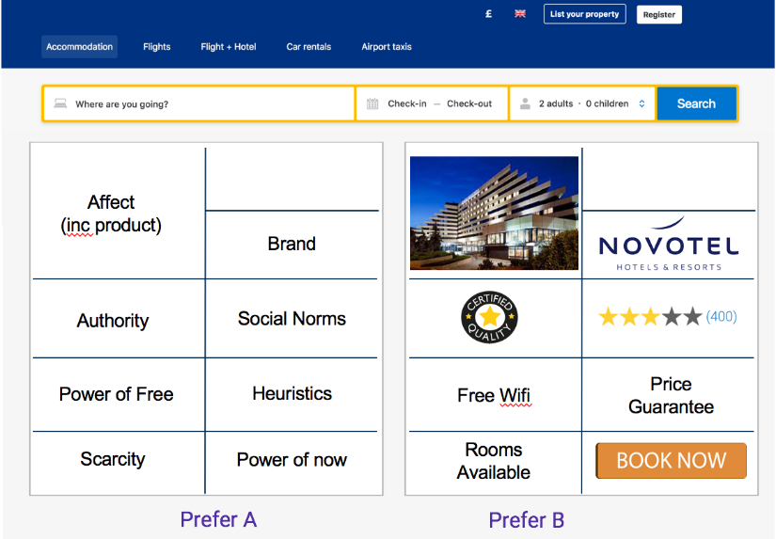
Brand 1
Brand 2
Free wheel upgrade
Largest boot space
Free car mat
32 miles per gallon
Free piggy bank toy
Ethical ISA
Free piggy bank toy
Ethical ISA
Only 5 remaining!
Drive away with your new car today
Deal of the month
Ready to drive away in just 7 days
Open with £1 today only
Applications approved next day
Open with £1 today only
Applications approved next day

Slide 39
2nd choice brand ‘supercharged’
100%
100
30
43
74
Authority Bias
80%
Power of Free
70
60%
67
70
Scarcity Bias
40%
57
Social Norms
20%
Category
Heuristics
26
Power of Now
0%
Stated 1st choice brand
Introduction of 2nd choice brand
2nd choice charged
2nd choice supercharged
1st choice brand share
2nd choice brand share
Source: Google commissioned UK research conducted by The Behavioural Architects. Based on 10,000 conjoint purchase simulations. n=1,000 category buyers (1,000 respondents, 10 simulations each). Respondents who never use Google Search or never use Amazon (2% of category buyers aged 18-65) were screened out before participating in the research

Slide 41
Test brand ‘supercharged’
100%
100
30
43
74
44
Authority Bias
80%
Power of Free
70
60%
67
70
Scarcity Bias
40%
57
56
Social Norms
20%
Category
Heuristics
26
Power of Now
0%
Stated 1st choice brand
Introduction of 2nd choice brand
2nd choice charged
2nd choice supercharged
Test brand supercharged
1st choice brand share
2nd choice brand share
Test brand share
Source: Google commissioned UK research conducted by The Behavioural Architects. Based on 10,000 conjoint purchase simulations. n=1,000 category buyers (1,000 respondents, 10 simulations each). Respondents who never use Google Search or never use Amazon (2% of category buyers aged 18-65) were screened out before participating in the research

Slide 42
In summary
Notes:
What we’re going to do now is summarise those same findings across all of our tested products. We have 3 conclusions, 3 charts and it usually takes about 3 minutes.

Slide 43
Ensure Brand Presence
Simply showing up can impact customer decision making when they are exploring and evaluating
Notes:
Number one [READ SLIDE]

Slide 44
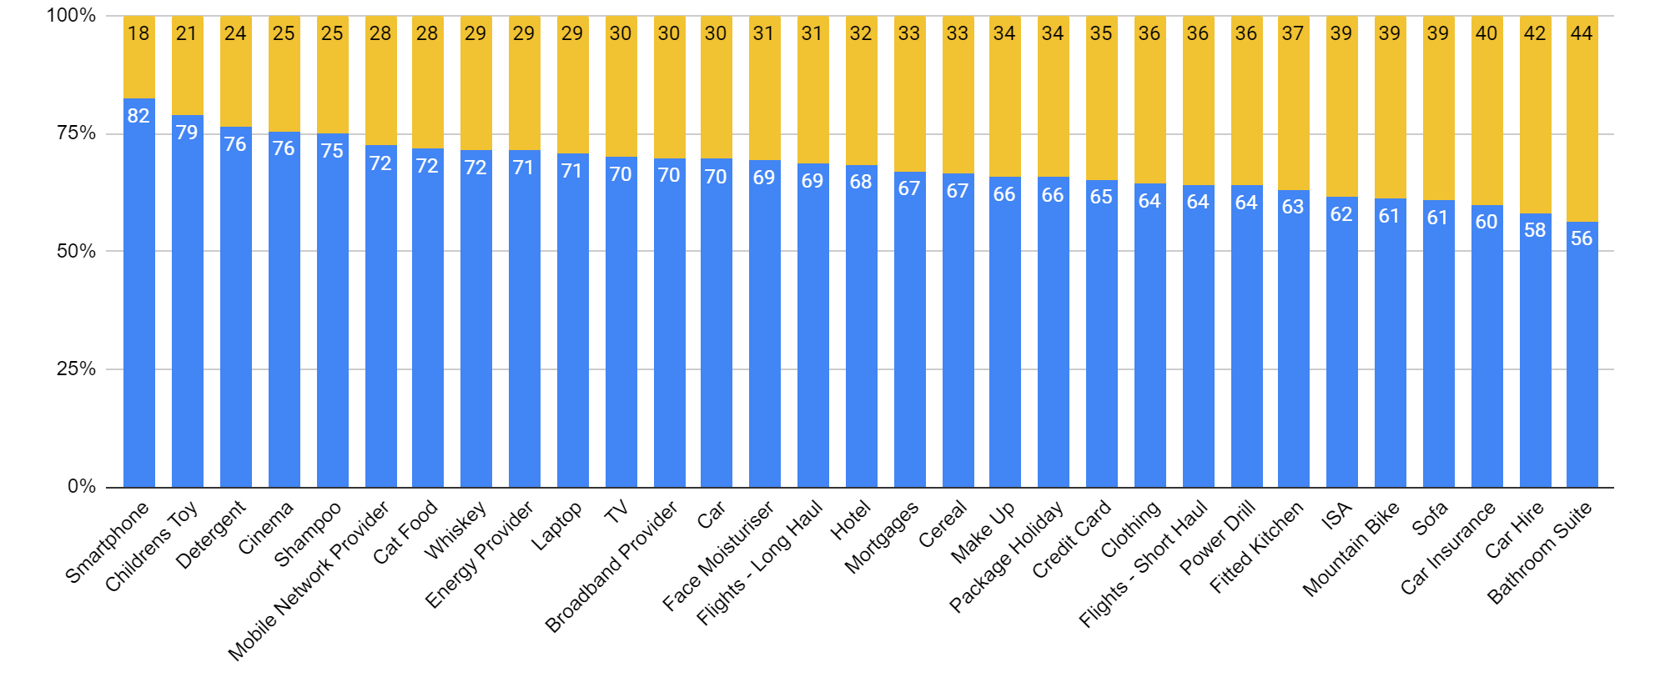
Introduction of the 2nd choice brand
Share preference after exposure to second choice brand with identical propositions
1st choice share
2nd choice share
Source: Google commissioned UK research conducted by The Behavioural Architects. Based on 310,000 conjoint purchase simulations.(31 categories x 1,000 category buyer respondents, 10 simulations each). Respondents who never use Google Search or never use Amazon (2% of category buyers aged 18-65) were screened out before participating in the research
Notes:
Here we see all 31 [UPDATE LOCALLY] of the products we tested in our simulation, The blue is the share of the first choice brand and the yellow is the share of the 2nd choice brand, and at this stage, the propositions in the simulation are identical, the only difference is the brand just as with saw previously for [INSERT CATEGORY USED IN THE MAIN PRESENTATION]
There is a potentially intuitive pattern as we move from left to right - we might have thought that some of these categories might be more commoditised but that won’t be true in every case and the research isn’t actually designed to support that conclusion. What is does tell us however, is that consistently, across all of these product categories, all a competitor has to do to take a significant share of the preference from the favourite brand, is just show up at the right time.
Simply showing up can impact customer decision making when they are exploring and evaluating
On average, across all the categories in our research, nearly a third of customers chose their second choice brand just because it was present. Event though the product and proposition were exactly the same.
Looking at the chart, the blue is the share for the first choice brand for each of the 31 products we tested and the yellow is the share for the second choice brand with an identical proposition.
Consistently across all 31 products, all a competitor has to do to take market share is just show up at the right time.

Slide 45
Intelligently (and responsibly) employ behavioural science principles
Leverage your brands’ assets to appeal to customers in the Messy Middle
Notes:
Second [READ SLIDE]

Slide 46
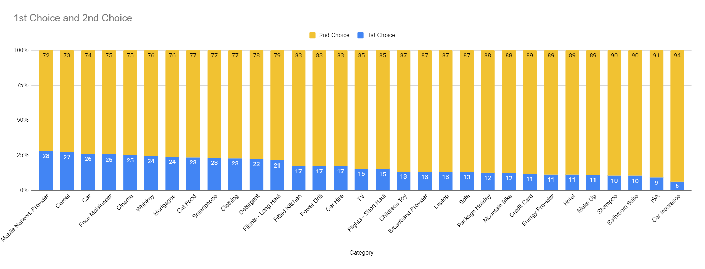
2nd choice brand ‘supercharged’
Share of preference when second choice brand is supercharged across all 6 biases
1st choice share
2nd choice share
Source: Google commissioned UK research conducted by The Behavioural Architects. Based on 310,000 conjoint purchase simulations.(31 categories x 1,000 category buyer respondents, 10 simulations each). Respondents who never use Google Search or never use Amazon (2% of category buyers aged 18-65) were screened out before participating in the research
Notes:
Again we see all of our tested products and again the blue is the share for the first choice brand but now the yellow is the share for the second choice brand, after it has been ‘supercharged’ across all 6 biases.
Across all 31 products tested, we see that discoveries made in the messy middle can often determine the outcome, and remember it’s not always the rational discoveries that have the biggest impact. So leverage your assets to align with these cognitive processes.

Slide 47
Close the gap between trigger and purchase
Help customers navigate the messy middle as efficiently and effectively as possible
Notes:
And lastly [READ SLIDE]

Slide 48
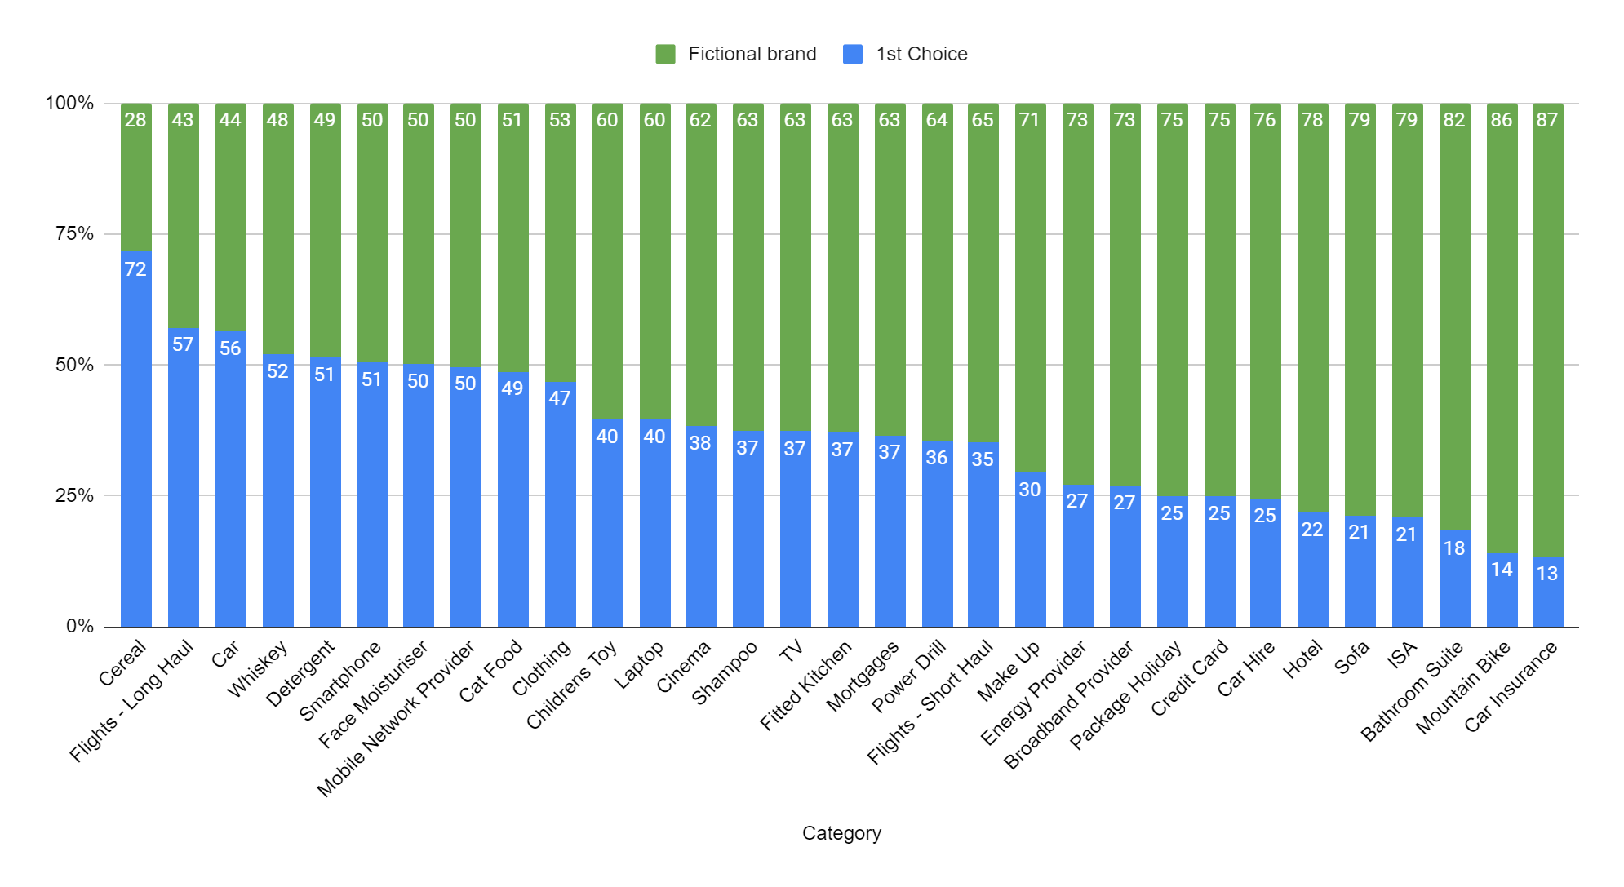
Fake brand ‘supercharged’
Share of 1st choice brand after supercharging fake brand across all six biases
1st choice share
Fake brand share
Source: Google commissioned UK research conducted by The Behavioural Architects. Based on 310,000 conjoint purchase simulations.(31 categories x 1,000 category buyer respondents, 10 simulations each). Respondents who never use Google Search or never use Amazon (2% of category buyers aged 18-65) were screened out before participating in the research
Notes:
Final chart, this time the blue is the share for the first choice brand and the green is the share for the fictitious test brand after we supercharged it across all 6 biases
Across all the categories we tested a fictional, supercharged fake brand - that none of the shoppers in our simulation had ever even heard of - was able to close the gap and take a significant share of preference from the 1st choice brand.
It’s worth remembering that the green is the share for the test brand after we had ‘supercharged’ it (authority bias, social proof, category heuristics, power of now, power of free, and scarcity bias), so that’ actually quite extreme, but a fake brand, that’s extreme too, and it’s also worth considering that while this may be only a fake brand in our simulation, it’s a pretty good proxy for a challenger brand in the real world. Remember that marketing history is littered with challenger brands that come from nowhere and seemingly, overnight, established themselves as a player.
So challenger brands, what can you do to supercharge your brand to acquire new customers? - and for established brands how can you do the same because for you this is just as important for attracting new customers as it is for keeping the ones you have already

Slide 49
Established Brands
Challenger Brands
Protect your customer, improve return on brand investment
Opportunity to win new customers and build brand
Notes:
In conclusion
[Established brands]
Brand represents a significant investment in terms of time, energy and money. Research is tells us that we’re probably not getting the return on that investment that you could be getting, given that all a competitor has to do to take some share is show up. So - use these insights to protect your customer between trigger to purchase, avoid the disruption, and get a better return on that brand investment. Equally, find ways to use these insights in ways that leverage your brand so that when you go into the loop as the no.2 or 3, you can can out as the no.1 And that’s crucial, because you can bet that challenger brands will be using a similar approach to appeal to your customers and build their business in this space
[Challenger Brands]
Conclusively then, there is clearly a massive opportunity for us to build on your brand and win new customers in this space. Not only can these insights level the playing the field, this is where we can build a real a truly disruptive competitive edge. We’ve shown what can be done with a fictitious brand that was created by our research folks in a dark room - imagine what we can do with [INSERT BRAND]

Slide 50
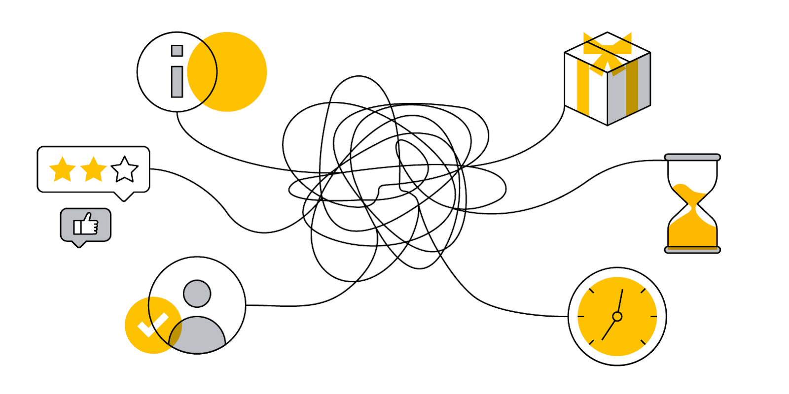
Has the 'messy middle' has become even messier in 2020?
Category Heuristics may be re-prioritised and new ones emerge
The Power of Free in a time of financial strain
Social Proof is dialled up
Power of Now: there’s still no time like the present
It’s a time for Authority
Tread carefully with Scarcity
Notes:
COVID-19 has caused established habits and routines to break, and in their place new consumer behaviours have sprung up. The onslaught of new information causes mental strain and means we have less bandwidth to spare. The spaces, places, and interactions that were the backbone of daily life have also radically changed. More people are spending more time online and adoption of digital solutions has accelerated, from video conferencing to the surge in online shopping and digital payments.
The COVID-19 context has resulted in people having to make new decisions, and even familiar decisions have been subject to increased scarcity and urgency. Some decision-making has sped up as people seek to secure access to things they want now, or they fear may not be available next week. Others have become harder and slower as people grapple with new ways of buying things or assessing whether now is really the right time.
In a world where people are having to cope with unprecedented uncertainty, a brand that can facilitate exploration, and assist with evaluation, is providing something truly valuable to their customers.

Slide 51
Thank you

Slide 52
Appendix: Methodology
12 categories: Car Insurance, Cat Food, Clothing: Jeans, Cosmetics: Mascara, Credit Cards, Domestic Flights, Domestic Hotels, Laptops, Running Shoes, Skincare: Moisturiser, SUV, TV
Qualitative | Screen Recording with Voice-over
10-days of online research missions capturing consumer decision making in real time
Respondent will complete 2 out of 12 selected categories
Participants record and narrate their decision making journeys live - both PC and mobile
Vendor moderates and observes decision making journeys to surface hidden influences affecting behaviour
Sample:
Participants recruited to be currently in the market for specific products and looking to buy in the close future
n=50 consumers per market
Quantitative | Conjoint Purchase Simulations
Exploring how 7 different BE executions can influence brand preference
Each respondent’s 1st & 2nd preference brands and a ‘fake’ brand in each category
Consumers answer conjoint simulation for 2 categories
Survey fielded on mobile and PC (46:54)
Sample:
n = 1,000 consumers per category
Participants recruited to be currently in the market for specific products and looking to buy in the close future
National representative sample within Google search addressable audience
Based on key demographics & regions/cities

